Slide 1
EXFO Summary Macro Presentation
Summer 2019
Amanda Page
Engineering Co-Op

Slide 2
Limitations
Cannot calculate cutback adjustments for Methods E, F or G
Only one cutback allowed per set of measurements
If two taken on accident, it will only apply the first cutback
Only works with folders of raw test data
Only pick one location to be used for RL in summary tab/for cutback
Only one set of specs allowed per set of data
If need more, different folders or use update summary button

Slide 3
About the Macro
This macro is for any single-mode raw data taken from the EXFO
It will:
Rearrange raw data
Apply cutbacks
Show IL and RL changes
Summarize the data
Highlight specs that fail in red
Create summary tables
It can handle:
Any kind of test from the EXFO (besides environmental)
Any number of fibers
Any number of wavelengths
Any amount of measurements

Slide 4
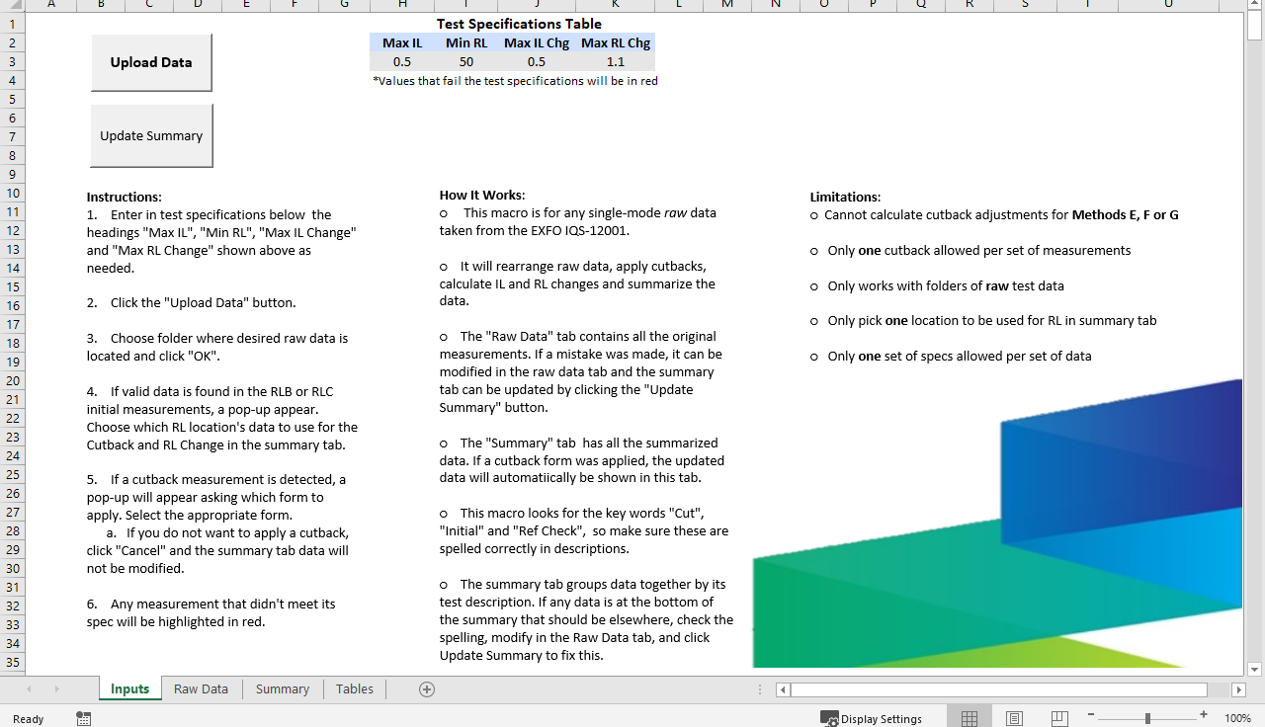
Home Page

Slide 5
What To Know Before Uploading Data
Return Loss Location
(A,B, or C)
Method Used
(B-H)
&

Slide 6
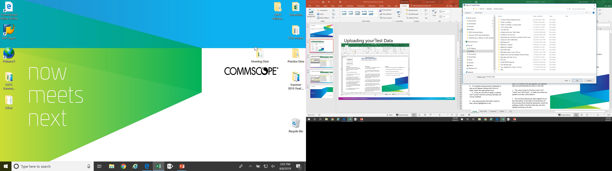
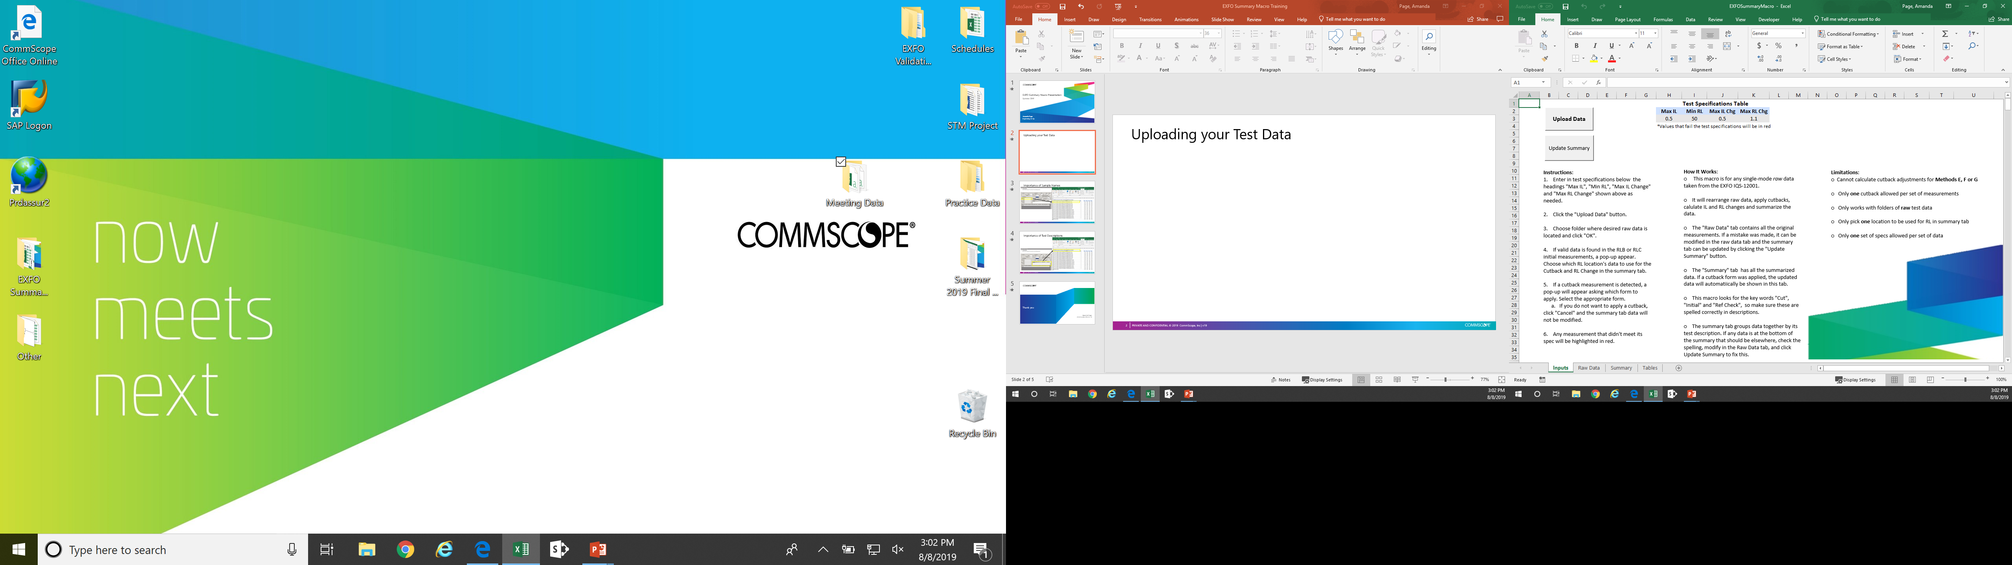
Uploading your Test Data

Slide 7
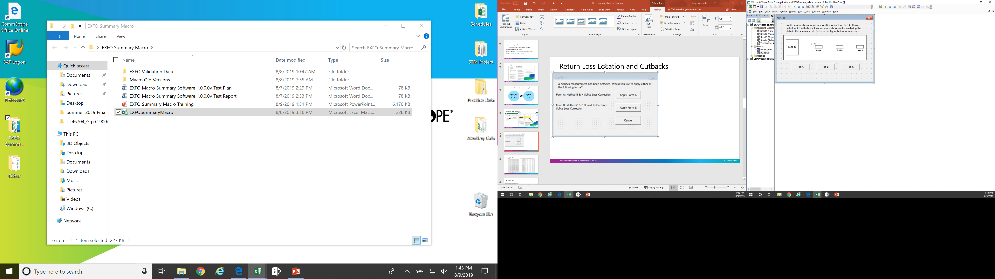

Return Loss Location and Cutbacks

Slide 8
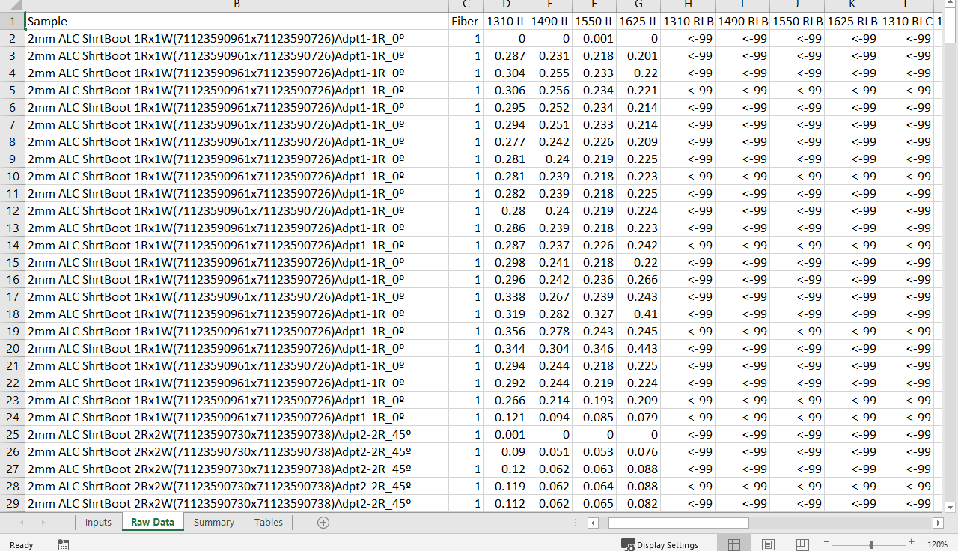
Raw Data Tab

Slide 9

Summary Tab

Slide 10
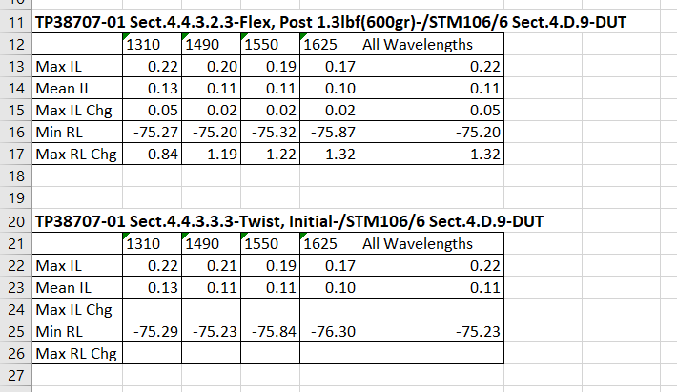
Summary Tables

Slide 11

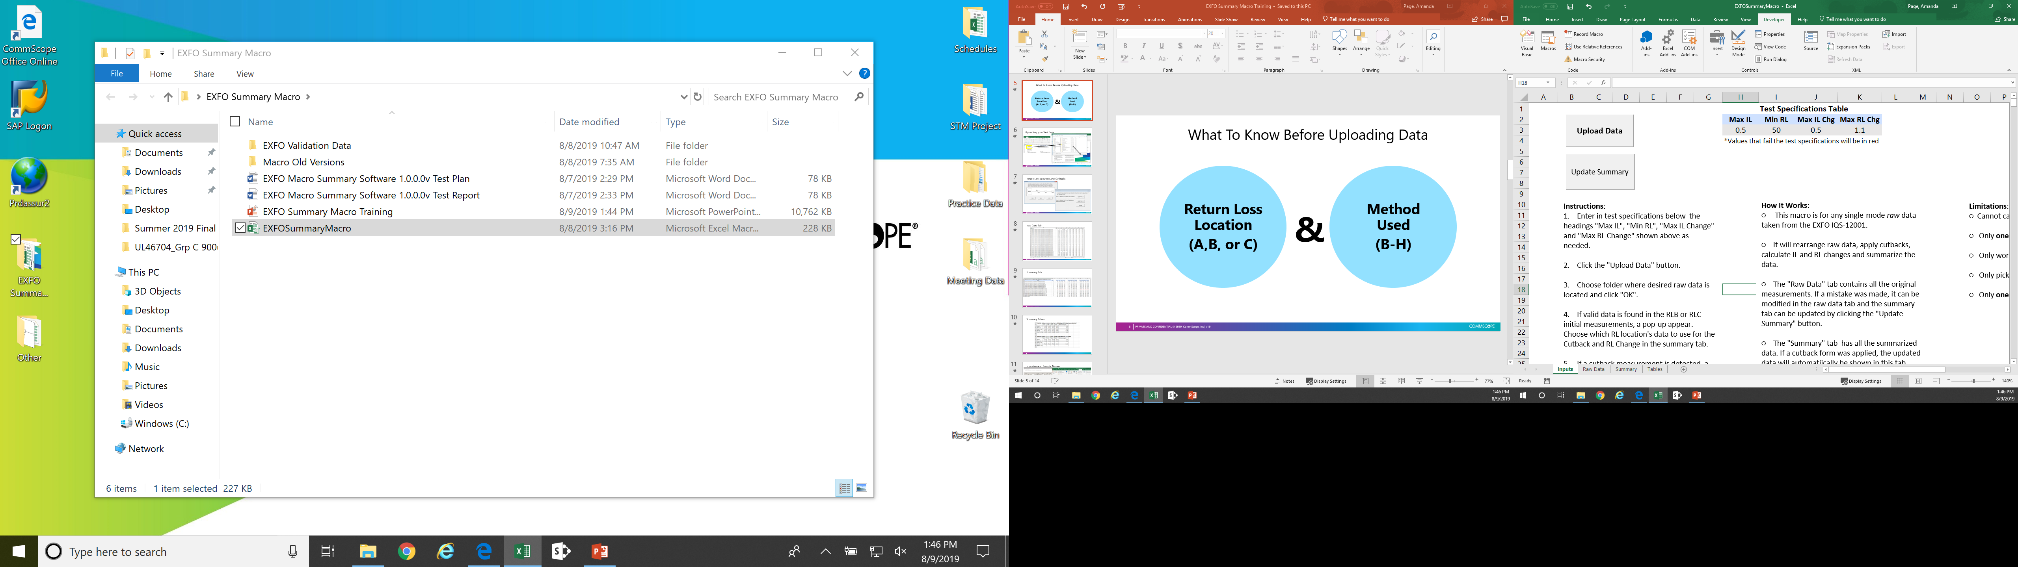
Update Summary Button

Slide 12
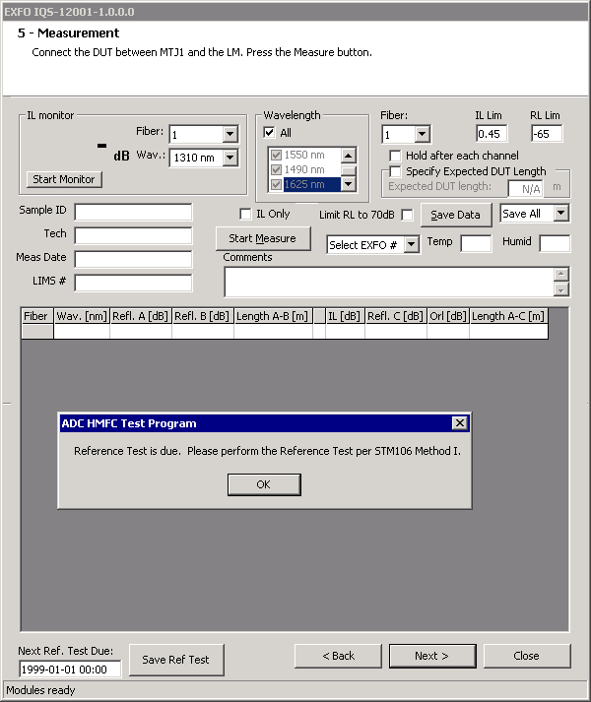
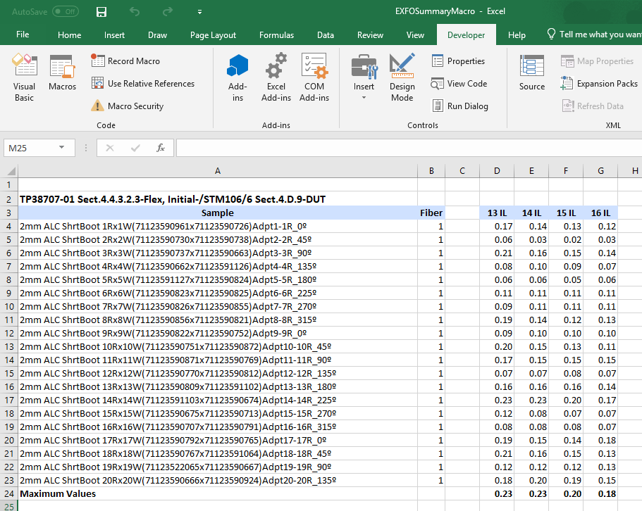
Importance of Sample Names
Cutback measurements look for sample names to apply!

Slide 13
Importance of Test Descriptions
Keywords:
Ref Check
Cut
Initial

Slide 14
I will be coming around this week to install this macro on laptops and train everyone in small groups so it’s more individualized for questions!

Slide 15
Thank you!
Amanda Page
amanda.page@commscope.com

